Slide 1
Share your Data - Repositories, data papers, and notebooks

Slide 2
Table of contents
01
03
02
04
Research Data Management
Jupyter notebooks
Sharing data through repositories
Documenting the data process with interactive Python Notebooks
Data papers
Ethics in data use
Enhancing data set discoverability with data papers in data journals
Considerations for ethical use and sharing of data sets

Slide 3
01
Research Data Management
Broader context for academic data sharing

Slide 4
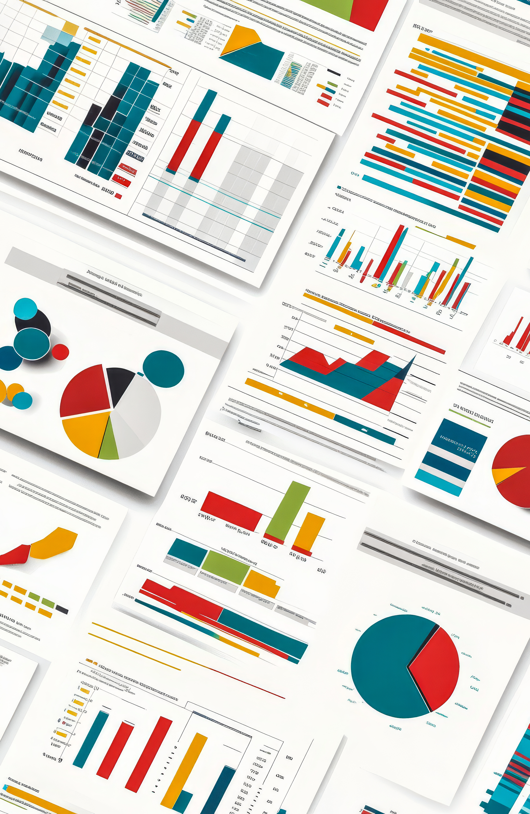
RDM
Research Data Management is the entire set of actions and processes involved in managing data during a research project.
Data collection strategy
Data storage strategy
Data sharing strategy
RDM is a large topic, most of which is beyond the scope of this talk. More information on RDM can be found in our RDM research guides:
https://libguides.utsa.edu/c.php?g=714236&p=5081377

Slide 5
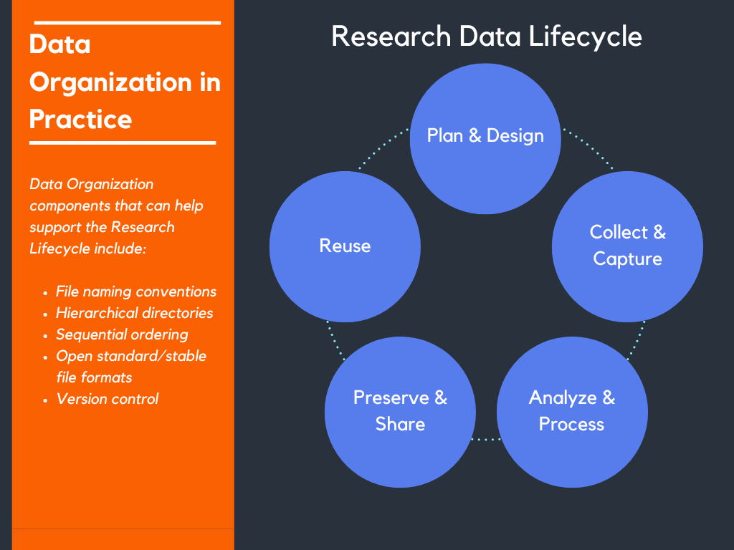
Research Data Lifecycle
Document, document, document!!!!
It’s sometimes easy to just plow ahead with data collection, processing, and analysis. However, careful documentation of all decisions during these stages is necessary in order to facilitate effective preservation, sharing, and reuse.

Slide 6
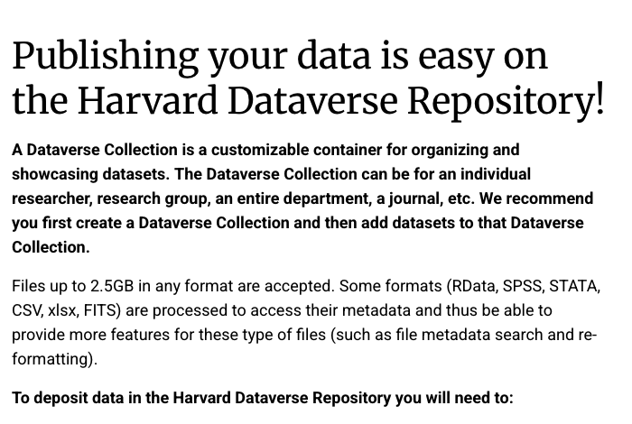
Data Repositories
As part of a data management plan, it is increasingly common to place raw data sets in a data repository. Popular repositories include:
Harvard Dataverse
Mendeley Data
Open Science Framework
Texas Data Repository
For sharing code, including Python code, GitHub repositories are the most popular solution.

Slide 7
File Formats
In these workshops we have used Python to create tabular data using the Pandas library. Using Pandas we can easily convert a data frame into highly portable, well recognized file formats, such as
csv (comma separated values)
xlsx (Microsoft Excel format)
ods (Open Document Spreadsheet, open-source spreadsheet format)
json (JavaScript Object Notation)
Here we will use csv.
Some fields have their own preferred file formats, such as FITS for astronomical data, ESRI shapefiles or GeoJSON for geospatial data. Plan your data storage format as part of your RDM. Favor: open-source, human-readable, portable (easy to change format and open in different packages and softwares).
Oregon libraries RDM file formats guide
RCSI libraries RDM file formats guide
USCB file naming guide

Slide 8
02
Data journals and data papers
Bringing visibility to your data set

Slide 9
Data journal
An academic journal that publishes descriptions of datasets, often without analysis or interpretation. The articles characteristic of data journals are called data papers. The focus of a data journal is the dataset itself rather than any specific research findings.
Characteristics
Data as scholarly output: Data journals elevate the production of datasets to the status of measurable research output, on a level with analytic findings or reasoned arguments.
Peer reviewed datasets: The peer review process in data journals looks at the quality, accessibility, and reusability of the dataset itself.
Promote data sharing and reuse: Data journals make datasets more findable and reusable.
Transparency for data processing: Data journals promote description of the collection, processing, and formatting of data, bringing transparency this part of the research process.

Slide 10
Lists of Data Journals
https://www.forschungsdaten.org/index.php/Data_Journals
https://mlibrarydata.wordpress.com/2014/05/09/data-journals/
MDPI Data journal
Chen, Ya-Ning. “An Analysis of Characteristics and Structures Embedded in Data Papers: A Preliminary Study.” Libellarium 9, no. 2 (2017): 145–56. List on page 148.
Wang, Xinyu, and Lei Xu. “What Are Journals and Reviewers Concerned About in Data Papers? Evidence From Journal Guidelines and Review Reports.” Learned Publishing 38, no. 2 (2025). List on page 4.
Walters, William H. “Data Journals: Incentivizing Data Access and Documentation within the Scholarly Communication System.” Insights the UKSG Journal 33, no. 1 (2020): 1–20. List on page 18.

Slide 11
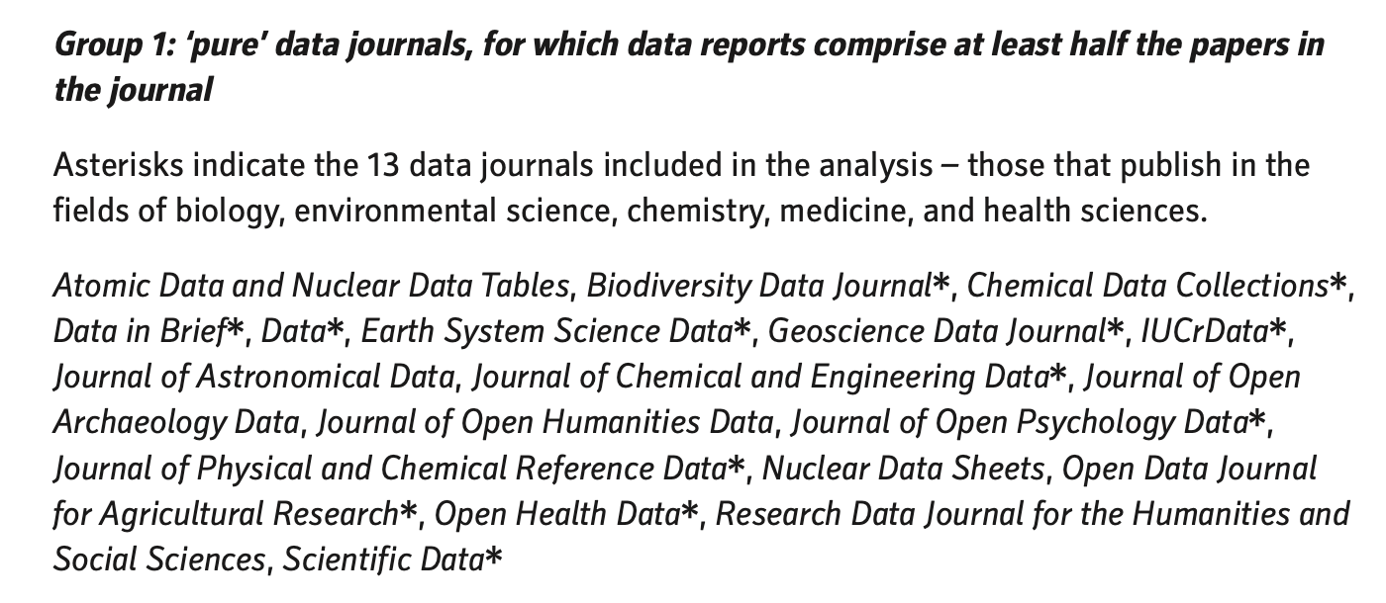
Source: Walters 2020

Slide 12
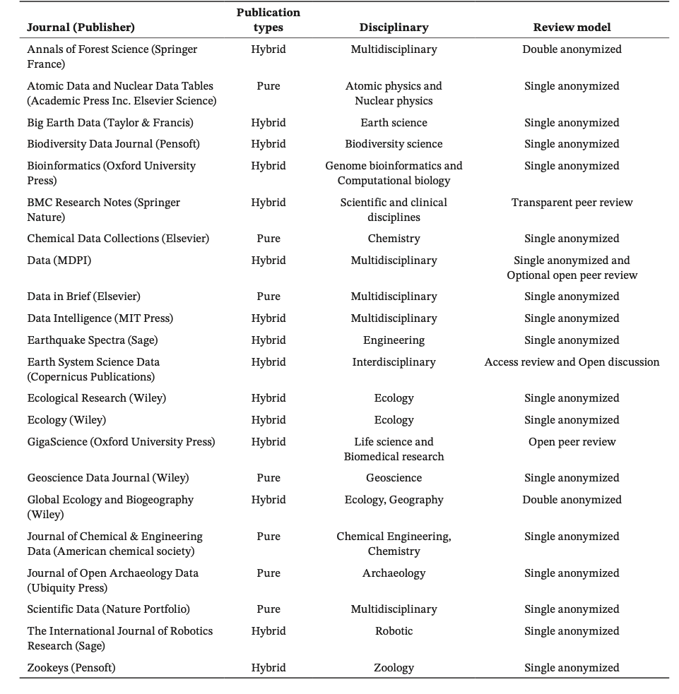
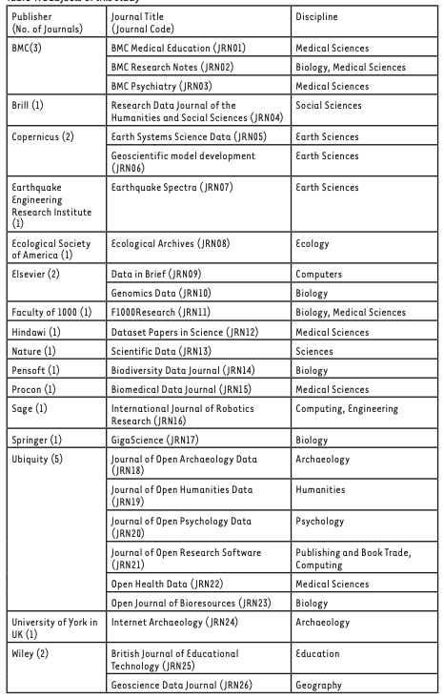
Right: Wang and Xu, 2025
Below: Chen, 2016

Slide 13
Data paper
A peer-reviewed paper that describes an existing data set to facilitate discovery, availability, and reusability.
Characteristics
Original findings not required: Data papers do not have to contain original findings.
Data description: Details the methods for creating and processing data, the data structure and format, and their potential for reuse. The what, when, where, why, and who of data.
Connect datasets to traditional papers: A data paper can serve as the bridge between raw data and more traditional academic publications.
Can sometimes contain analysis: Although data papers are by definition more descriptive than analytic, some also contain analysis and conclusions, depending on journal guidelines.

Slide 14
Components of data papers
Vary across journals.
How was the data created?
How was the data processed?
How was the data analyzed? (Description of the analysis process, not presentation of analysis conclusions.)
Description of data structure and format
Data management plan
Reusability potential
Temporal and spatial coverage
Licensing and usage. Most datasets are part of open data / open science and have free reuse licenses
Ethical considerations, particularly when using human subjects or animal research
Conflict of interest statement
Sources: Chen 2016, Wang and Xu 2025

Slide 15
To facilitate publication and sharing, researchers must carefully document the steps taken in processing data.

Slide 16
03
Python Notebooks
A means of documenting and sharing your data process

Slide 17
Interactive Computational Notebooks
An early form was created by Stephen Wolfram for doing math on computers: the Mathematica software (1988) could do math and output visualizations.
Wolfram wrote "The idea of a notebook is to have an interactive document that freely mixes code, results, graphics, text and everything else.”
Colombian physicist Fernando Pérez created iPython in 2001, then created Project Jupyter in 2014
Notebooks:
Are able to execute code and show output in the same document
Combine code with rich text documentation
Include visualizations, including interactive visualizations
Can include media content such as images and links

Slide 18
Notebooks
Main uses
Use cases
Examples
Document how you developed your code
Document how your code works
Document your coding workflow
Demonstrate or illustrate a coding technique
Document data science workflow
Create visualizations
Interactive tutorials
Document your experimentation with techniques
Exploratory data analysis
Notebooks for Digital Humanities
Documenting an experimental DH workflow
Interactive Machine Learning Tutorial

Slide 19



Disadvantages
Complex projects
Code completion
Code completion not as good as IDEs
Automatic error checking not as good as IDEs
No version control integration
Can’t do complex multi-file projects or modular projects
Can’t use popular Python web frameworks like Django or Flask

Slide 20
Main Shortcuts
Command mode: ESC or click outside cell
Edit mode: Enter or click inside cell
IN COMMAND MODE:
Insert new cell above: A
Insert new cell below: B
Convert cell to Markdown: M
Convert cell to Code: Y
Delete cell: DD
Execute cell: Shift + Enter
Execute and insert below: Alt/Option + Enter
Navigate between cells: up and down arrows
Remember:
When you restart a notebook, none of the variables and functions are in memory anymore. You have to run the cells again to get those variables in memory.
When in doubt, restart kernel ☺
Learn to run all cells or run cell and all below.

Slide 21
Markdown
Main things to know:
The Markdown Guide is just a click away
Use headings correctly. Always use the correct hierarchy from first level downwards
# Heading level 1
## Heading level 2
### Heading level 3
Use backticks `` for code snippets that are not intended to run
Use dashes for unordered lists
One asterisk for italics
Two asterisks for bold
Links:
[Link label](Link URL)
Images:
![alt text](path/to/image “optional title”)
Did I mention the Markdown Guide is just a click away ☺

Slide 22
04
Ethical and Philosophical Considerations
Because academic environments are where these questions should be addressed ...

Slide 23
Using a data article to present research results can lead to neglecting details of data structure, and the ”rationale, design, logical foundation, philosophy, and ethics” that lead to the creation of the data. These details are important for data reusability. To what extent can emphasis on results at the expense of data in data articles lead to limited reusability? Does this turn a data journal into merely a low-quality research journal? (Vuong, La and Nguyen 2024)
How can we address the conflict between the requirement to share publicly funded data and the requirement to protect private information and participant identity? (Dilles 2023)
How do we effectively anonymize data on human subjects? (Dilles 2023)

Slide 24
How do we protect Indigenous communities from nonconsensual data sharing and the use of data in ways contrary to community beliefs and values? (Crowder and Freeman 2020; Pasquetto et al. 2024)
How do manage potential conflicts between the philosophy of open data and the needs of communities regarding data ownership? (Poirier et al. 2020)
How can we avoid or discourage misuse of data? Can we predict what our data is going to be used for?

Slide 25
Misuse cases
Sharks
Blood samples
Algorithms and data
Researchers tagged sharks for conservation purposes. A government agency used the data to target a tagged shark as a threat, leading to its illegal killing.
Blood samples collected from from Indigenous communities for a diabetes study were used for commercial purposes including pharmaceuticals development without renewing informed consent.
A local government used an algorithmic model to predict child abuse risk. Data from public sources overrepresented low-income families because less data existed on wealthier families.
Source: Pasquetto et al. 2024

Slide 26
Crowder, Jerome W., Richard B Freeman, Mike Fortun, Rachel Besara, and Lindsay Poirier. “Introduction.” In Anthropological Data in the Digital Age, 1–12. Cham: Springer International Publishing, 2019.
Dilles, Zoe Y. G. “Data Journals: Where Data Sharing Policy Meets Practice.” Master’s Thesis, School of Information and Library Science, University of North Carolina at Chapel Hill, 2023.
Pasquetto, Irene V., Zoë Cullen, Andrea Thomer, and Morgan Wofford. “What Is Research Data ‘Misuse’? And How Can It Be Prevented or Mitigated?” Journal of the Association for Information Science and Technology 75, no. 12 (2024): 1413–29.
Poirier, Lindsay, Kim Fortun, and Brandon Costelloe-Kuehn. “Metadata, Digital Infrastructure, and the Data Ideologies of Cultural Anthropology”. In Anthropological Data in the Digital Age, 209-237. Cham: Springer International Publishing, 2019.
Vuong, Quan-Hoang, Viet-Phuong La, and Minh-Hoang Nguyen. ”Critical Remarks on Current Practices of Data Article Publishing: Issues, Challenges, and Recommendations.” Data Science and Informetrics, In press, Journal Pre-proof. https://doi.org/10.1016/j.dsim.2025.01.009

Slide 27
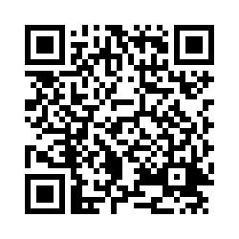
Please take this short survey!

Slide 28
Thanks!
Do you have any questions?
diane.lopez2@utsa.edu
javier.ruedas@utsa.edu
Please keep this slide for attribution

